Slide 1
INDIA
PHYSICAL ENVIRONMENT - NORTHERN MOUNTAINS
ATULYA INSTITUTE
PREPARED BY
AYAN BISWAS
(FACULTY MEMBER OF GEOGRAPHY)

Slide 2

PHYSIOGRAPHIC DIVISIONS OF INDIA
1
THE NORTHERN MOUNTAINOUS
REGION
3
THE PENINSULAR PLATEAU
5
THE ISLANDS
2
THE GREAT NORTHERN PLAINS
4
THE COASTAL
PLAINS

Slide 3
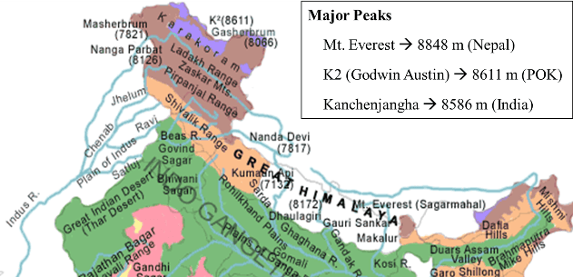
NORTHERN MOUNTAINOUS REGIONS

Slide 4
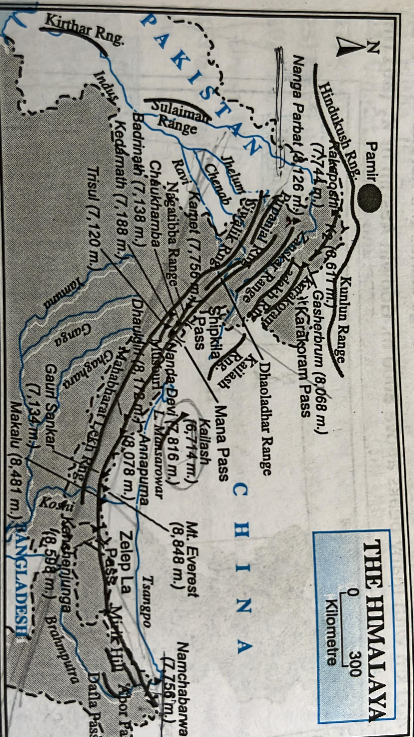
THE NORTHERN MOUNTAINOUS REGIONS CONSISTS OF -
THE HIMALAYAS
THE LADAKH RANGE
THE KARAKORAM RANGE
THE PURBANCHAL OR NORTH EASTERN HIMALAYA

Slide 5
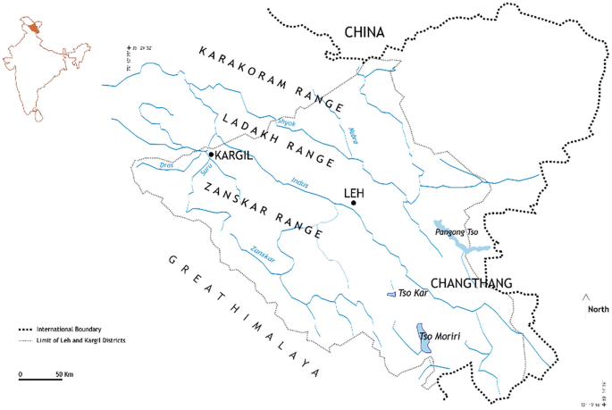
THE LADAKH RANGE -
STRETCH - 350 KM
HAS MANY PEAKS ABOVE 6000 M
TO THE NORTH EAST OF IT LIES THE LADAKH PLATEAU WHICH IS THE HIGHEST COLD PLATEAU (4000 M) OF INDIA .

Slide 6
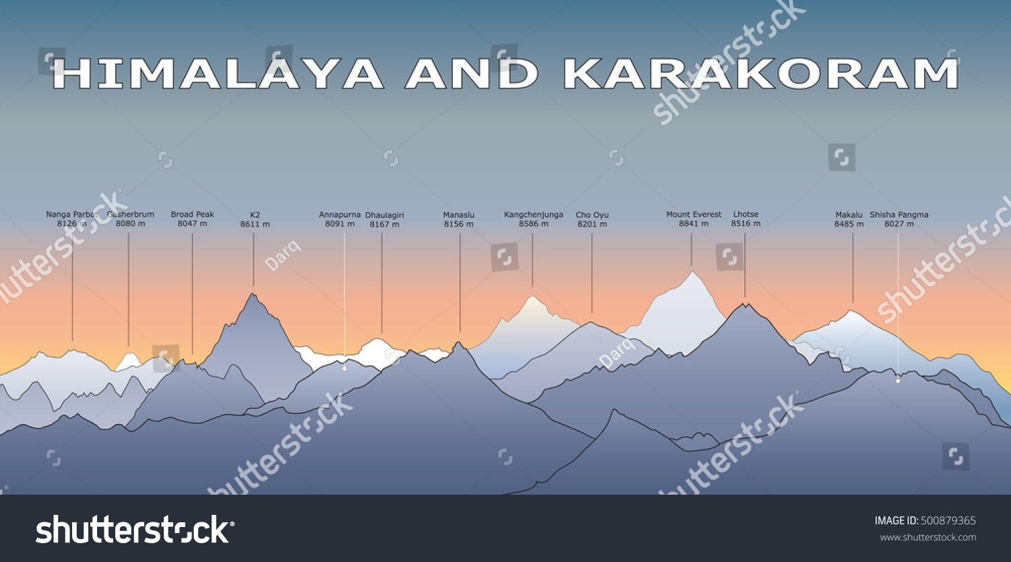
THE KARAKORAM RANGE -
LIES FURTHUR NORTH TO LADAKH RANGE
STRETCH - 400 KM
MT.GODWIN AUSTEN OR K₂ (8611 M) IS THE HIGHEST PEAK THAT LIES HERE ,
SIACHEN , THE LONGEST GLACIER OF INDIA BELONGS TO THIS RANGE

Slide 7
NORTH SOUTH DIVISION OF HIMALAYAS
DIVSION | POSITION | AVERAGE HEIGHT | IMPORTANT PEAKS
TETHYS OR TIBETIAN HIMALAYAS | LIES IN EXTREME NORTH | 5500 TO 6000 M | MERGES WITH TIBETIAN PLATEAU MOST OF THIS HIMALAYAS LIE IN CHINA.
HIMADRI OR GREATER HIMALAYAS | SOUTH TO THE TIBETIAN HIMALAYAS | 6000M | MT EVEREST (8848 M) HIGHEST PEAK OF WORLD LIES HERE. KUNCHENJUNGHA , HIGHEST PEAK OF INDIA , NANDADEVI ,ANNAPURNA
HIMACHAL OR MIDDLE HIMALAYAS | LIES SOUTH TO THE HIMADRI HIMALAYAS | 2000 TO 3000 M | MUSSOURIE , PIRPANJAL , NAGTIBBA , DHOALADHAR PEAKS.
SHIWALIK OR LOWER HIMALAYAS | IT IS THE SOUTHRENMOST RANGE OF HIMALAYAS | 600 TO 1500 M | JAMMU, DAFLA RANGES FORMED DUE TO THIRD PHASE OF UPLIFTMENT OF HIMALAYAS

Slide 8
EAST WEST DIVISION OF HIMALAYAS -
THE WESTERN HIMALAYAS -
KASHMIR HIMALAYAS
HIMACHAL HIMALAYAS
KUMAON HIMALAYAS
CENTRAL HIMALAYAS - (BELONGS TO NEPAL )
EASTERN HIMALAYAS -
SIKKIM DARJEELING HIMALAYAS
BHUTAN HIMALAYAS
ASSAM OR ARUNACHAL HIMALAYAS

Slide 9
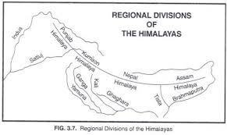

Slide 10
EAST TO WEST COMPLETE DIVISION -
East west Divison of Himalayas is done on this basis of rivers, It has been divided into 6 divisions.-
Kashmir or Northwestern Himalayas( Indus River and Sutlej),
The Himachal and Uttarakhand Himalayas (Satlej to Kali),
Nepal Himalayas (Kali-Kosi),
The Darjeeling and Sikkim Himalayas (Kosi-Teesta),
Arunachal Himalayas (From Teesta and Dihang),
The Eastern Hills and Mountains(Beyond Dihang

Slide 11
WESTERN HIMALAYAS
On the basis of regional characteristics, the Himalayas can be divided into three sub-regions: (1) The Western Himalayas, (2) The Central Himalayas (belongs to Nepal), and (3) The Eastern Himalayas. The Central Himalayas in Nepal include the lofty peaks of Mt. Everest, Dhaulagiri, Annapurna, etc.
(1) The Western Himalayas - It may be subdivided into three regions:
(a) The Kashmir Himalayas - It belongs to the state of Jammu and Kashmir. To the extreme south stand the Jammu and Punch hills.
Further north is the Pir Panjal range. To the north of Pir Panjal lies the famous Kashmir Valley, which is bordered on the north by the Himadri and Zanskar ranges. Further north lies the Indus Gorge. To the extreme north stands the Karakoram Range. Godwin Austen or K2, the highest peak of the Karakoram Range, belongs to India.
(b) Himachal Pradesh Himalayas - It belongs to the state of Himachal Pradesh. To the extreme south stands the Siwalik range. Further north stands the Lesser Himalayan ranges, namely Dhauladhar, Pir Panjal, Nagtibba and Mussoorie.
(c) Kumaon or Uttarakhand Himalayas - It belongs to the state of Uttarakhand. To the extreme south are found a few famous valleys or duns, namely Dehra Dun, Choukhamba, etc. To the north of these valleys stand the Nagtibba and Mussoorie range. Further north are found lofty snow-capped peaks, such as Nanda Devi (7817 m), Gangotri (6114 m), Kedarnath (7188 m), etc.

Slide 12
EASTERN HIMALAYAS
(2) The Eastern Himalayas - It can be divided into three sub-regions:
(a) Sikkim-Darjeeling Himalayas - There are three important ranges, namely Singalila, Dawhill, and Dongkia. Kanchenjungha (8598 m), the third highest peak in the world, belongs to the Sikkim Himalaya, and this is the highest peak of the Himalayas in India.
(b) Bhutan Himalayas - The topography of this region is very much rugged. Kula Kangri (7554 m) is the highest peak of this region.
(c) Assam or Arunachal Himalayas - It belongs to the state of Arunachal Pradesh. The Siwalik range stands to the north of the Brahmaputra Valley. Further north stands the Lesser Himalayas, and to the extreme north stands the Great Himalayas.

Slide 13
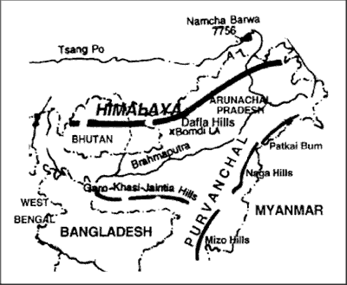
NORTH EASTERN HIMALAYAS OR PURVANCHAL
The Purbachal lies in the North-east of India, extending in a north-south direction in the states of Assam, Arunachal Pradesh, Nagaland, Manipur, Mizoram, and Tripura.
There are many ranges of low height varying between 1800 m and 4000 m.
These hills are the southern continuation of the Himalayan ranges.
These are Patkoi and Mishmi in Arunachal Pradesh, Naga hills in Nagaland, the highest peak of which is Saramati (3825 m).
Tuensang in Manipur, Mikir, and Barail hills in Assam are connecting Khasi-Garo-Jaintia hills of Meghalaya.
Dafabum (4579 m) of Mishmi hills of Arunachal Pradesh is the highest peak of this region.

Slide 14

T

